Slide 1
Top Ten Reasons to Hire Me
The Computer Mama

Slide 2
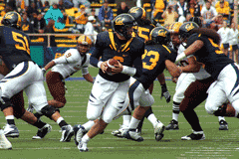
10.Football

Slide 3
9. Track

Slide 4
8. Hockey

Slide 5
7. Baseball

Slide 6
6. Wrestling

Slide 7
5. Swimming

Slide 8
4. Volleyball

Slide 9
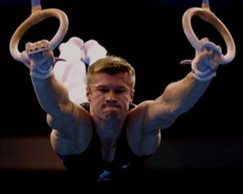
3. Gymnastics

Slide 10
2. Basketball
Sample 1
Sample 2
Sample 3

Slide 11
1. We complete the team!

